Slide 1
20200123 Three outputs – masterplan display / specific building main façade display / numeric display

Slide 2
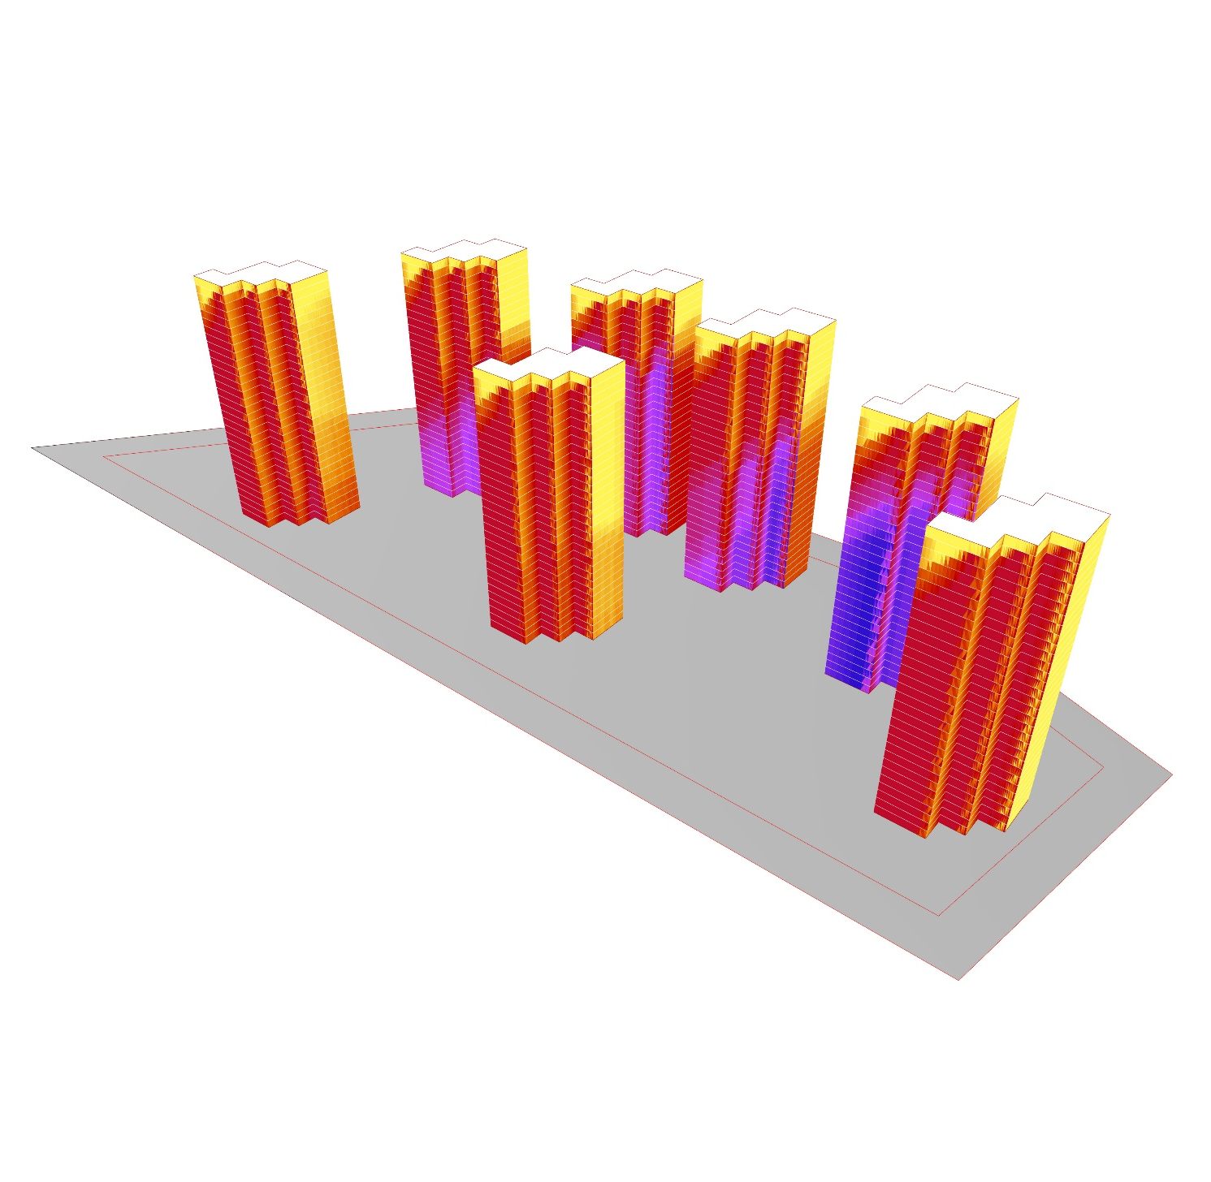
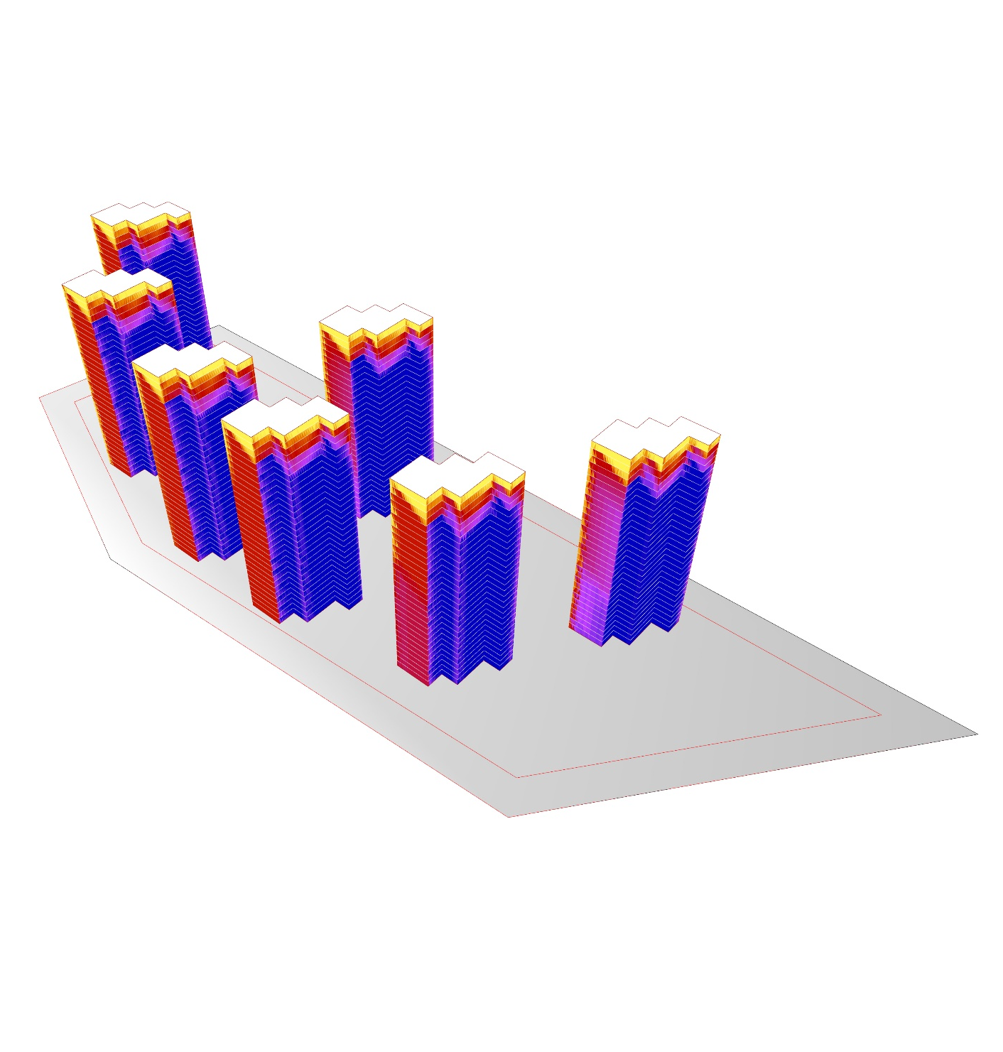
Main façade (S,W)
Other façade (E,N)
Daylight analysis - masterplanning

Slide 3
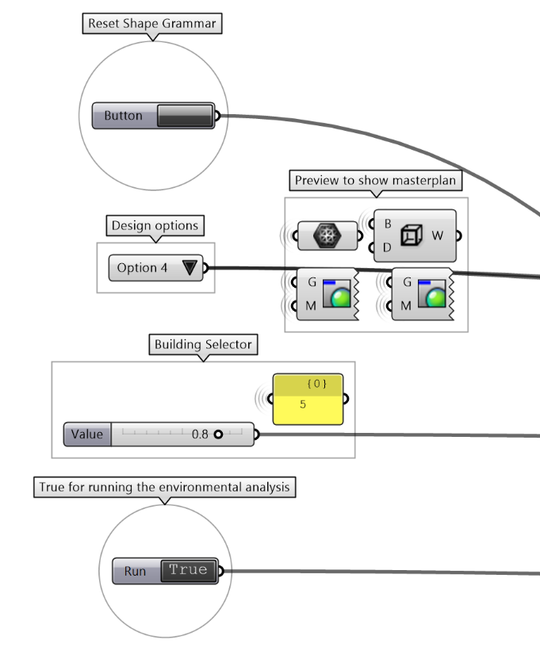

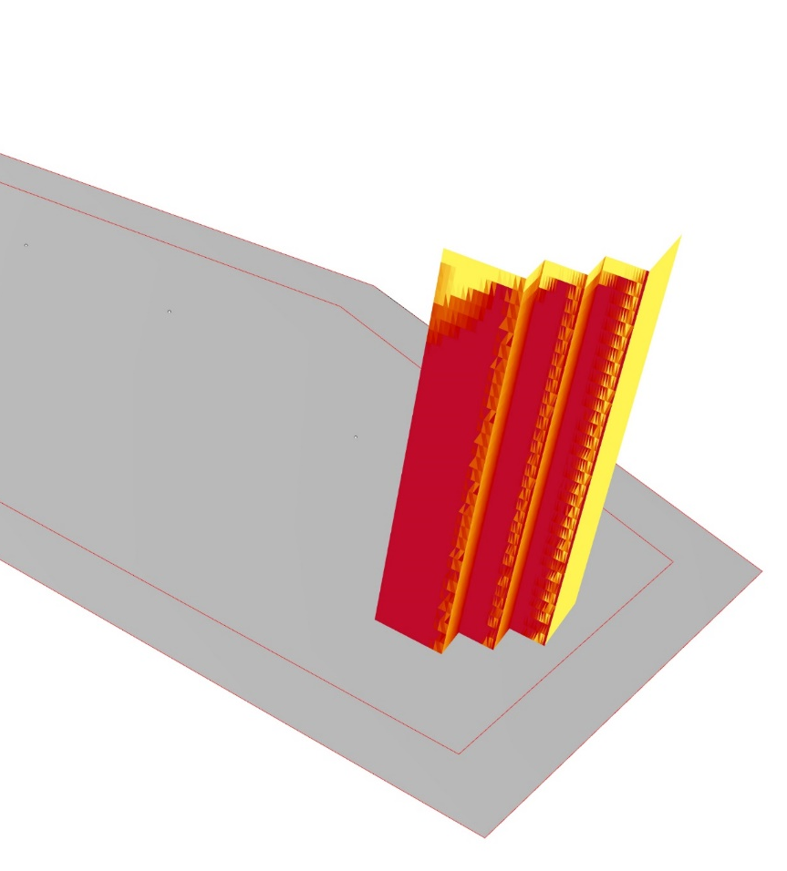
All facades
Extracted main facade
Three output from analysis (1): analysis mesh

Slide 4
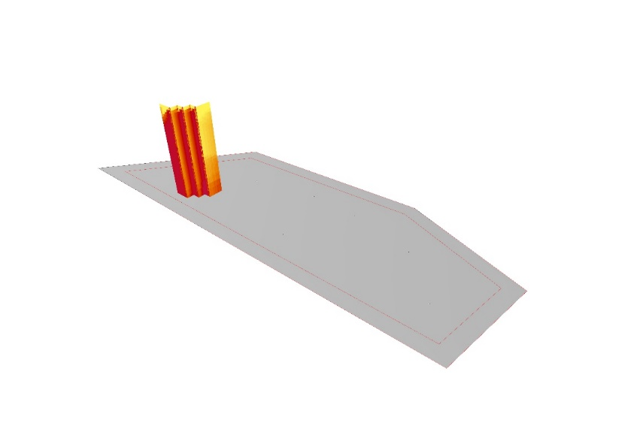
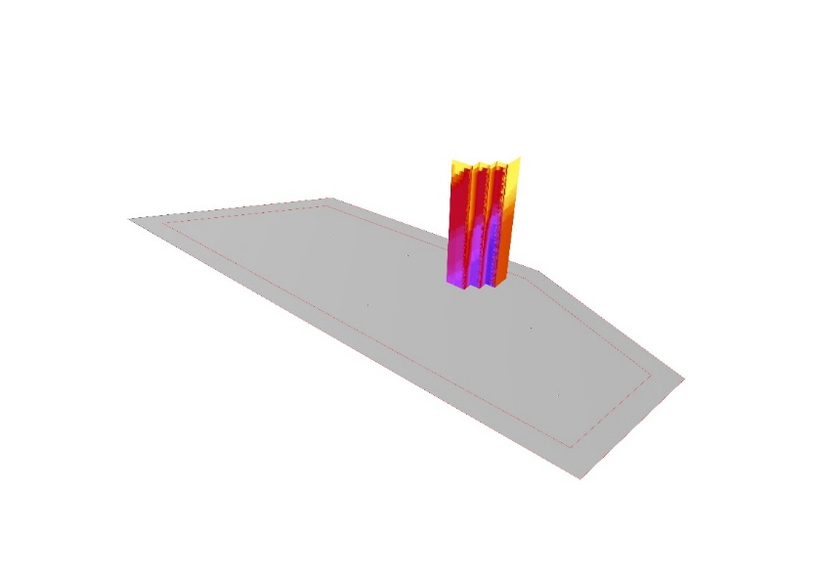

Daylight analysis – extracting main façades

Slide 5
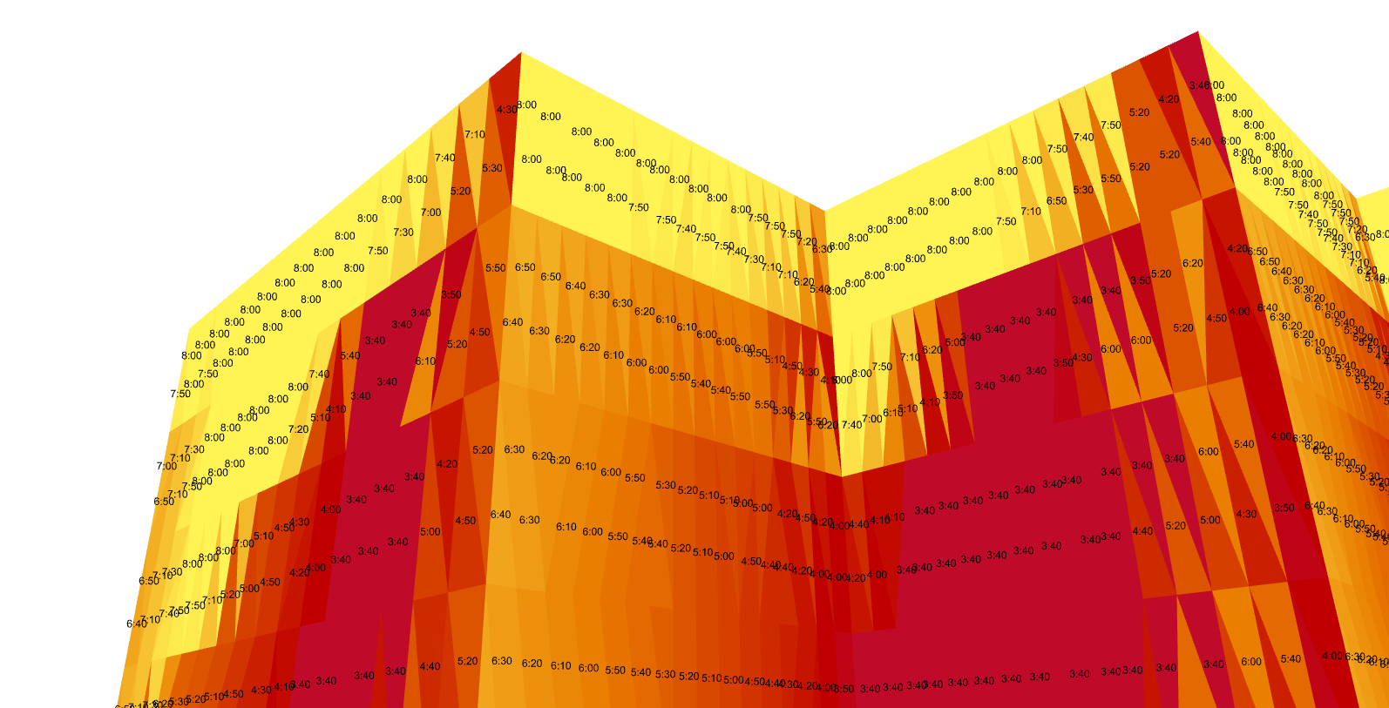
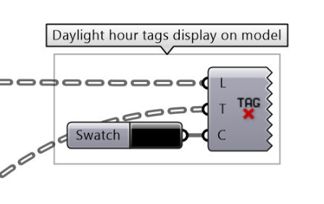
Three output from analysis (2): number of daylight hours

Slide 6
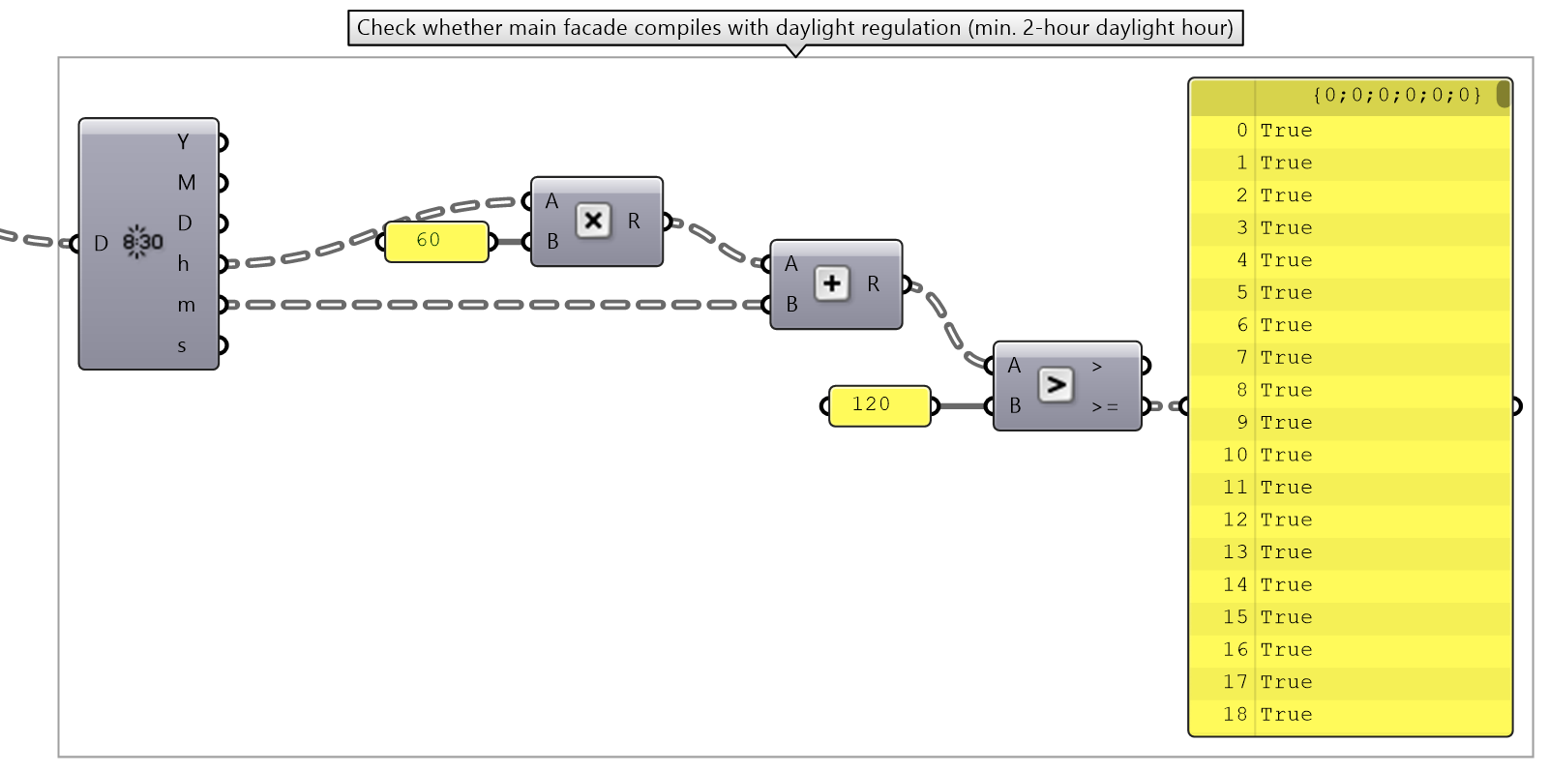
Three output from analysis (3): check whether compile with regulation or not (2-hour)

Slide 7
20200129 three tests summary

Slide 8
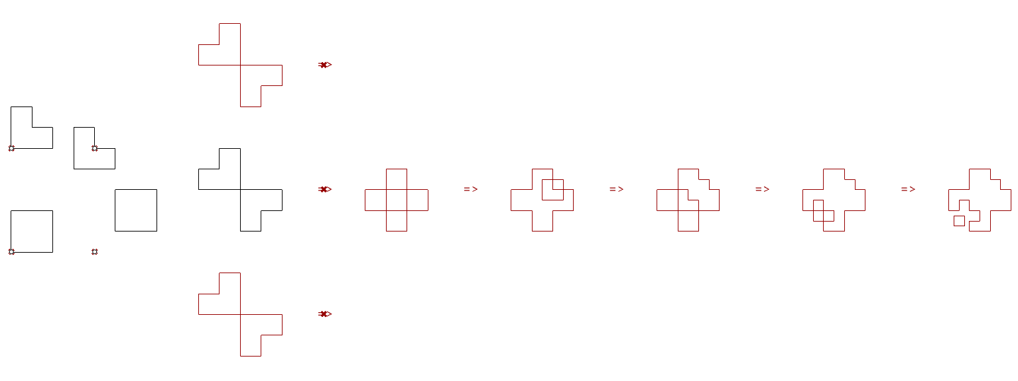
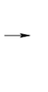
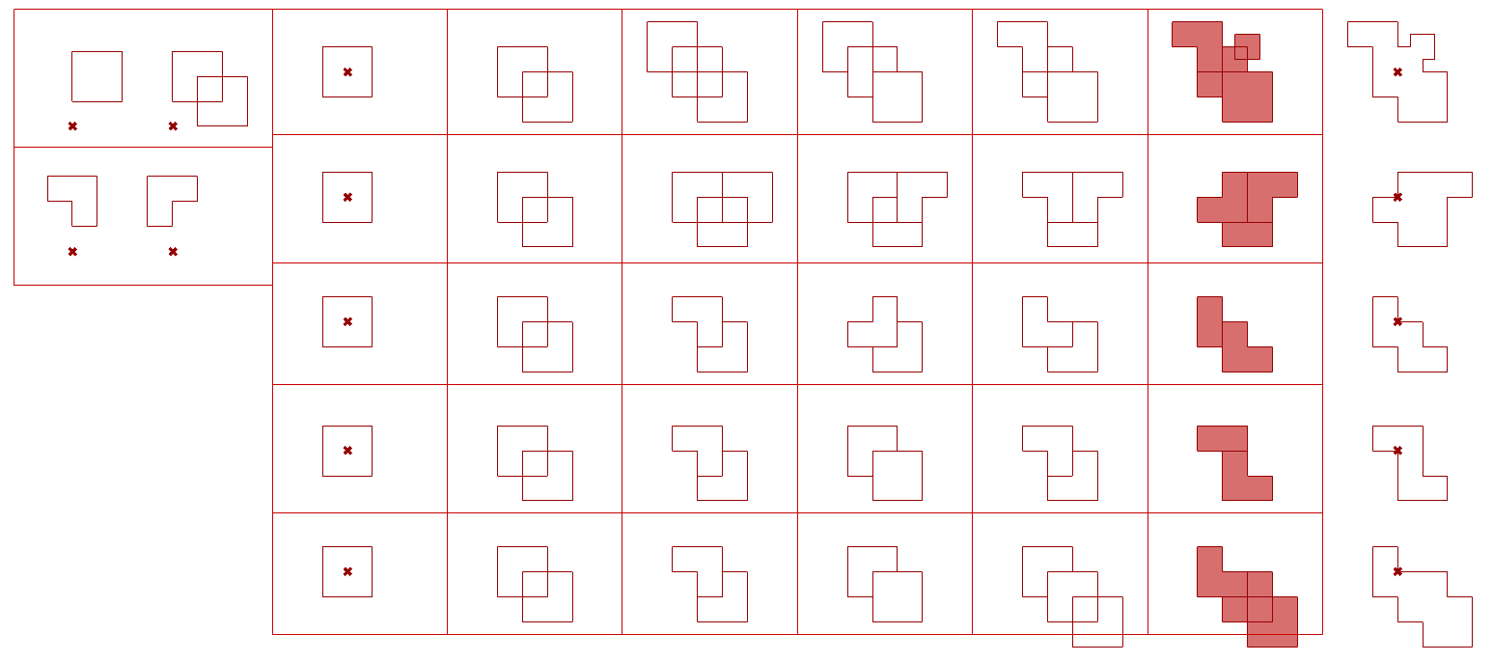
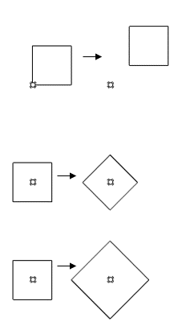
Maintain
Transformation
Transformation
Transformation type
Rules
Eculidean
Shape, size
Translation / rotation
Test 1
Translation only
Eculidean
Affine
Parallelism
Scale
Similarity
Shape
Scale and rotation
Test 2
Translation, mirror
Eculidean
Morph
Topological relationships
Morph
Four basic types of transformation
AAD_Algorithms-Aided_Design, pp184
Test 3
Translation, scale and rotation
Eculidean and similarity
Our three tests
Set up three Shape Grammar tests according to different transformation combination

Slide 9
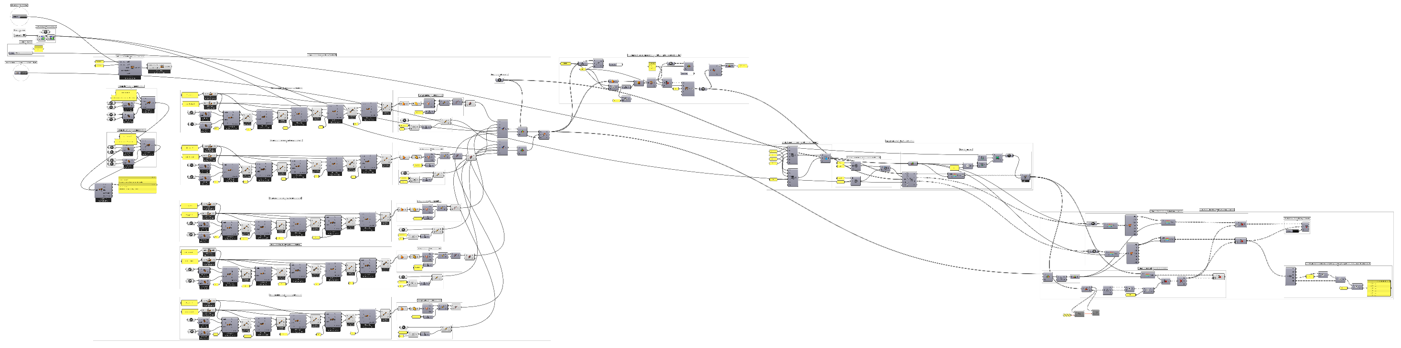
Setup and display
Shape grammar
(by SortalGI)
Building modelling
Daylight analysis
(by Sunflower Pro)
Extract and check main façade data
Overall script – shape grammar and daylight analysis

Slide 10
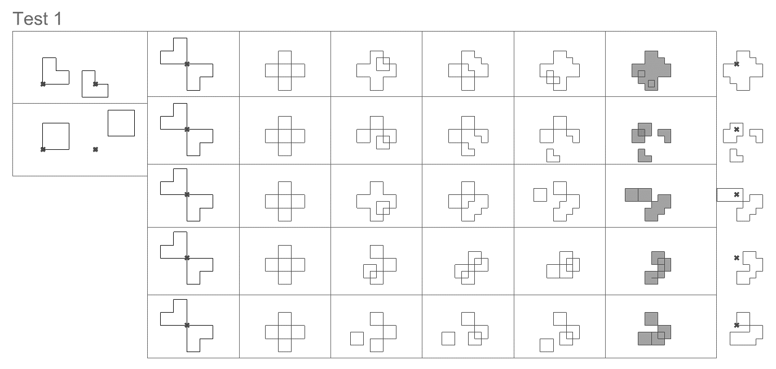
Rule 1 moves L-shape down and right
Test 1a
Rule 2 moves square up and right
Test 1b
Test 1c
Test 1d
Test 1e
Rules
5 tests of different transformations
Building outlines
Test 1 – translations only

Slide 11
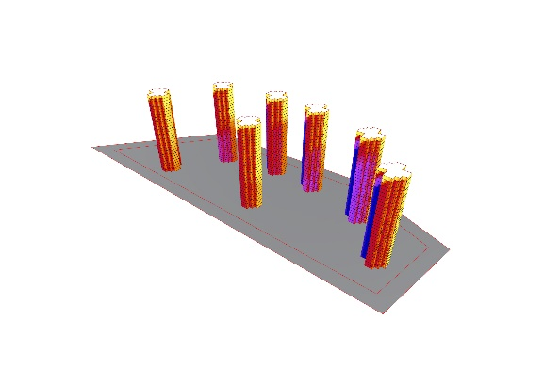
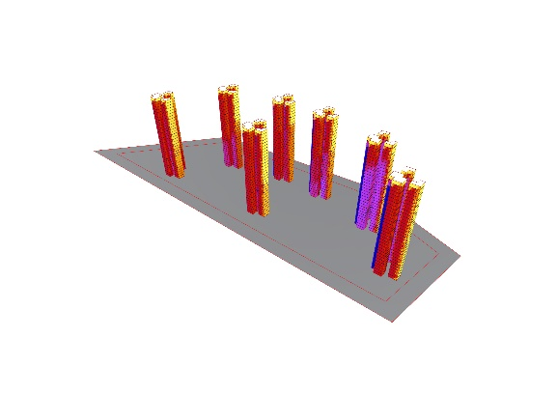
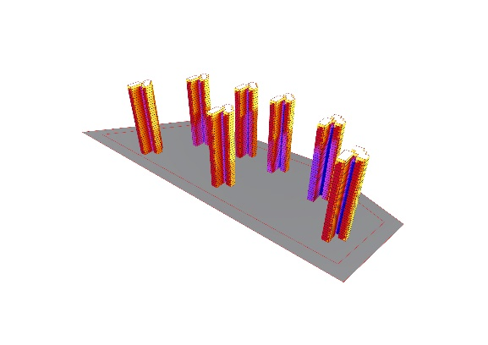
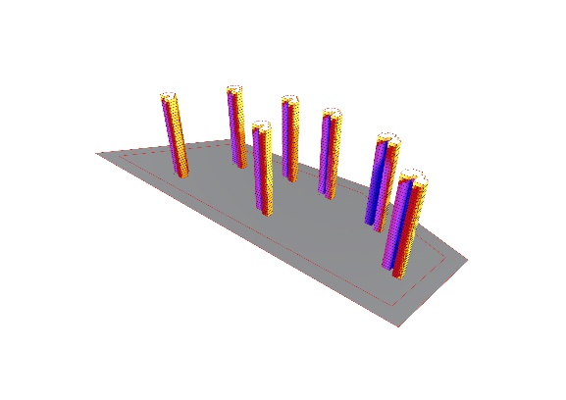
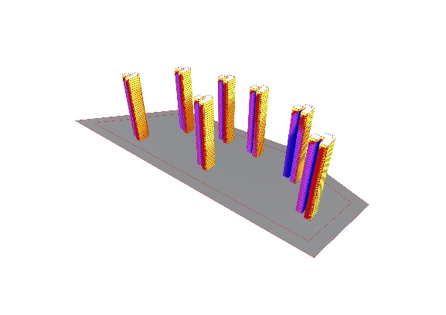
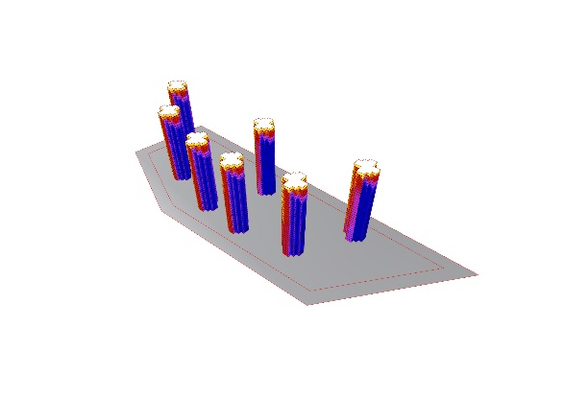
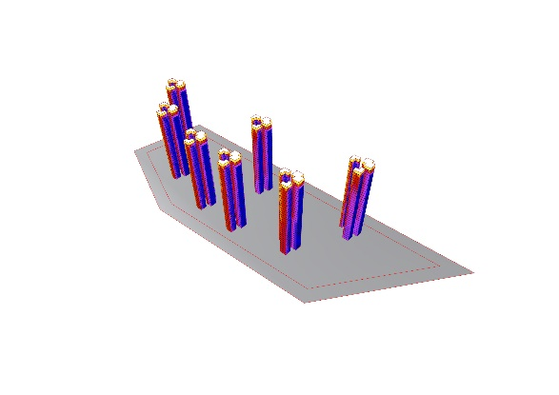
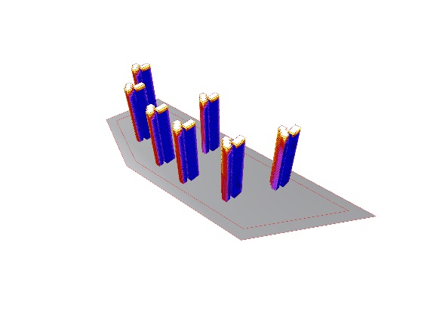
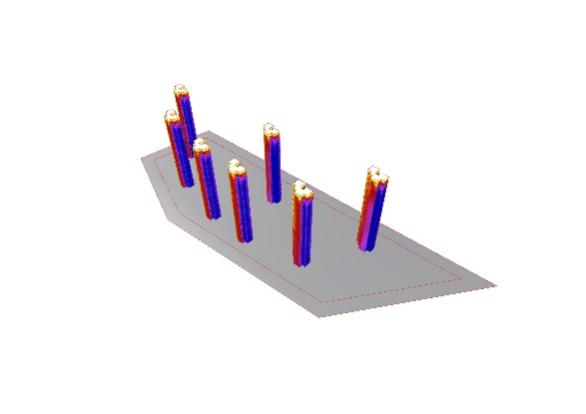

Option 0
Option 1
Option 2
Option 3
Option 4
Test 2 – Daylight analysis - masterplanning

Slide 12
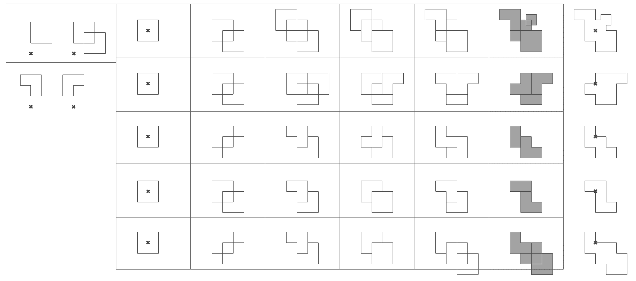
Rule 1 duplicates a square down and right
Test 2a
Rule 2 mirrors the L-shape vertically
Test 2b
Test 2c
Test 2d
Test 2e
Rules
5 tests of different transformations
Building outlines
Test 2 – translation, mirror

Slide 13
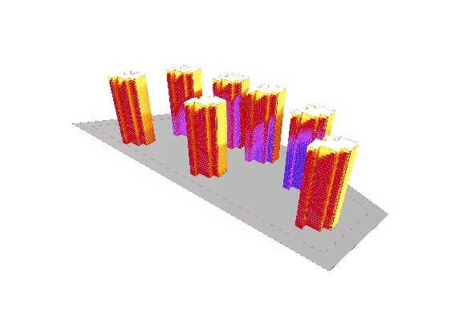
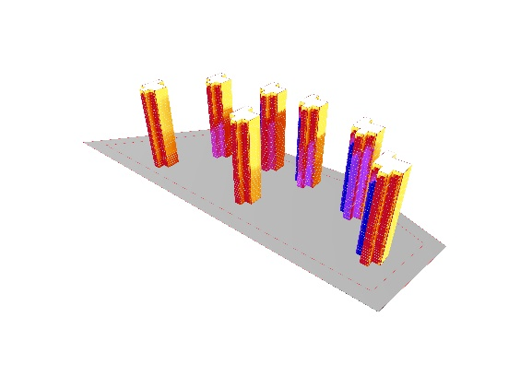

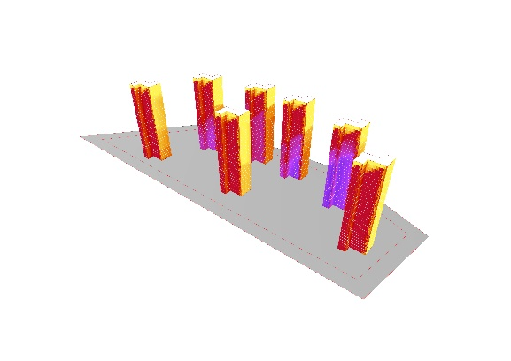

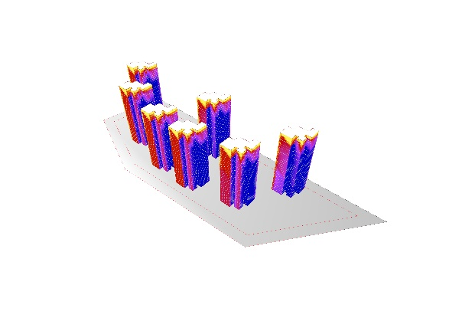
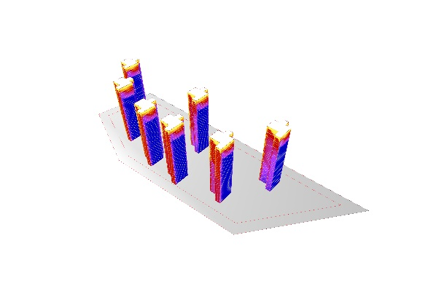
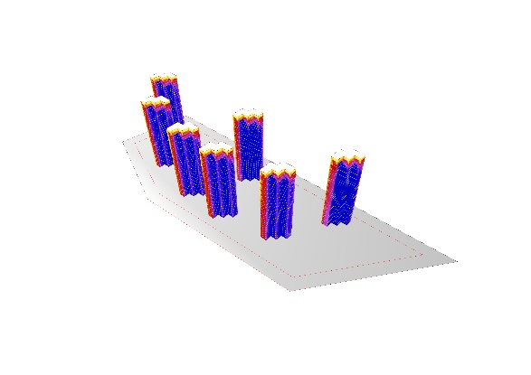
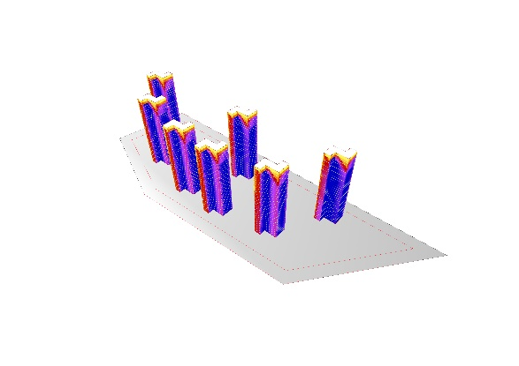

Option 0
Option 1
Option 2
Option 3
Option 4
Test 2 – Daylight analysis - masterplanning

Slide 14
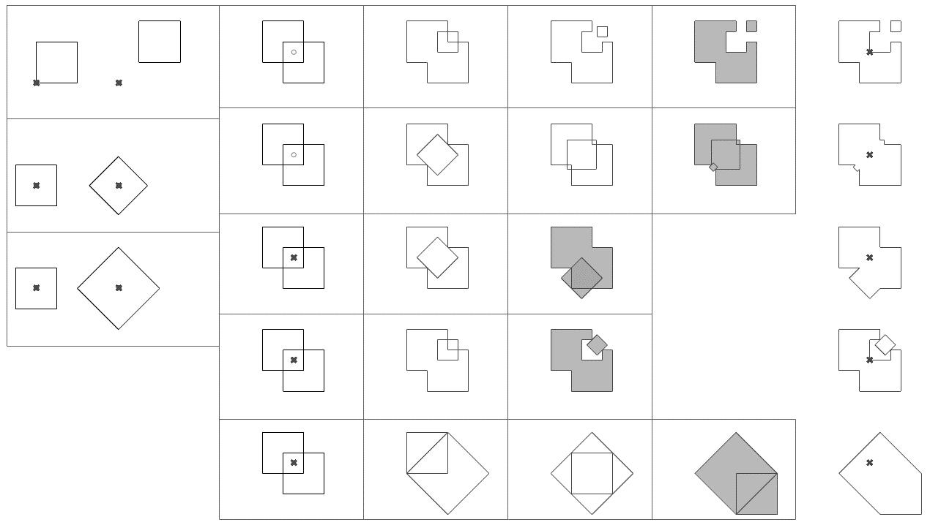
Rule 1 moves a square diagonally
Test 3a
Rule 2 rotates a square 45 degrees
Test 3b
Rule 3 rotates a square 45 degrees and scale up by sqrt2
Test 3c
Test 3d
Test 3e
Rules
5 tests of different transformations
Building outlines
Test 3 – translation, scale and rotation

Slide 15

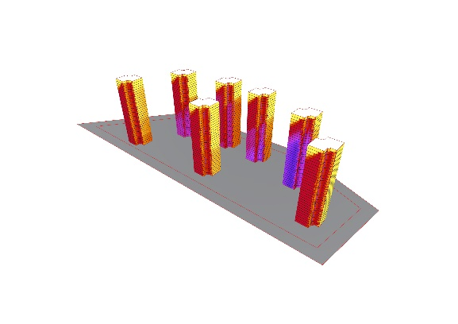


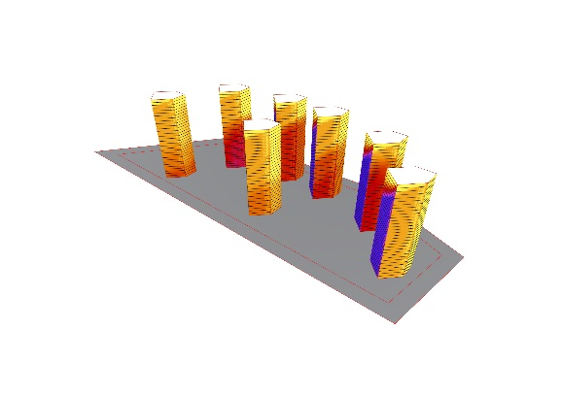
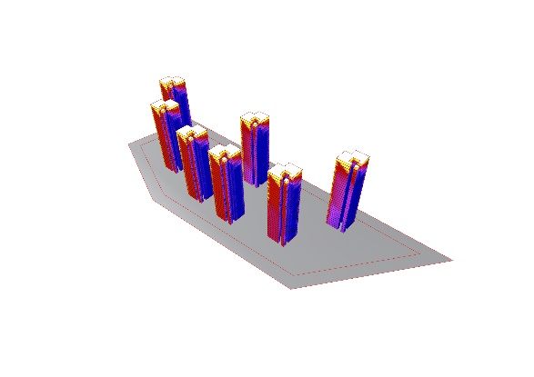
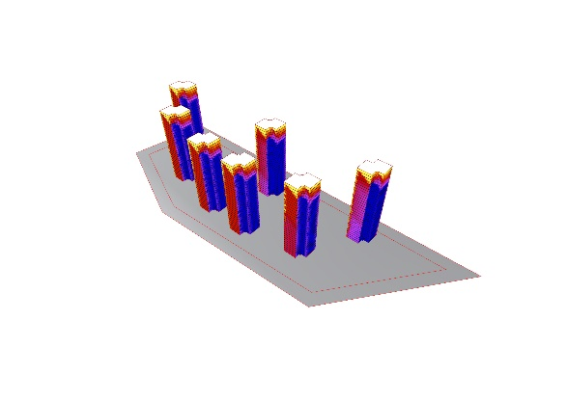
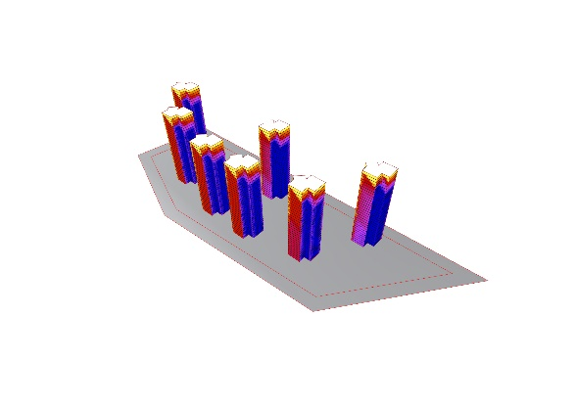
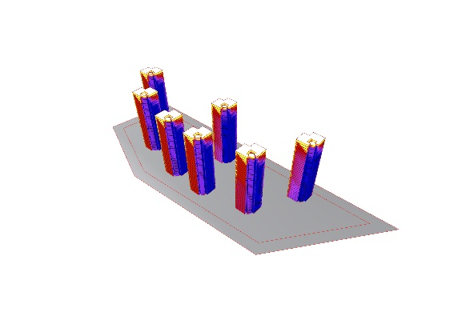
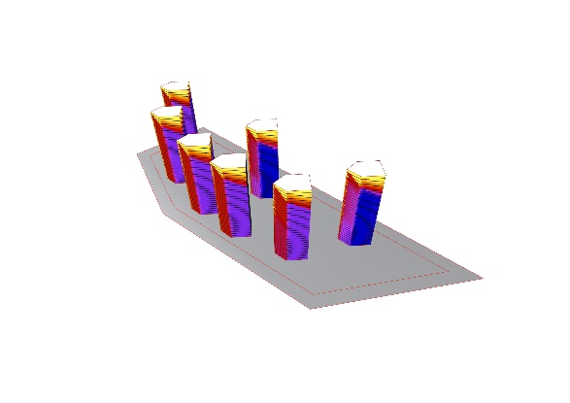
Option 0
Option 1
Option 2
Option 3
Option 4
Test 3 – Daylight analysis - masterplanning

